Slide 1
Roster Construction and Offensive Consistency
Bill Petti
Saberseminar
August 2015
Boston, MA

Slide 2
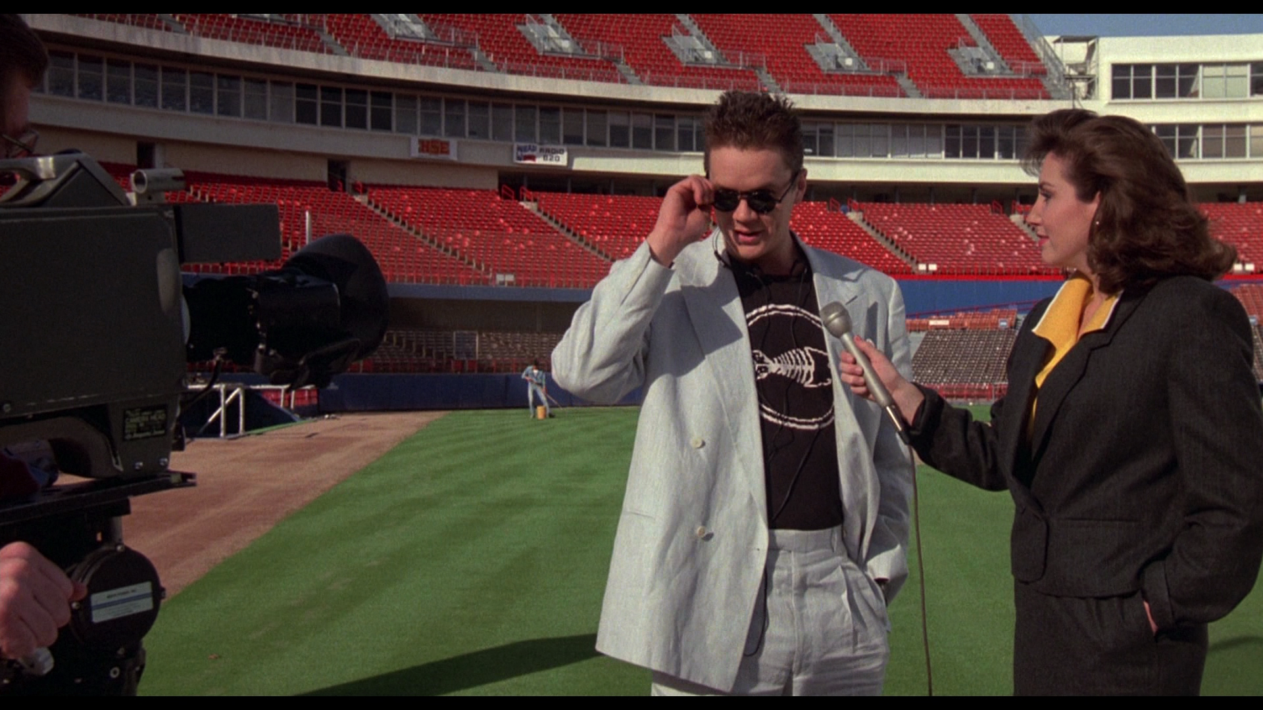
Let’s Make This a Little Interactive: Presentation Cliché Game

Slide 3
How Many Will You Hear/See Today?
“Needed to start somewhere”
“Not sure what to make of the results”
“Take the results with a grain of salt”
“Results directional, but not definitive”
“More questions than answers”
“A lot more work to be done”

Slide 4
Motivating Questions
Is there an advantage to distributing a team’s runs more consistently throughout a season?
Are there differences in how individual hitters distribute their runs over the course of a season?
Are certain types of hitters more consistent than others?

Slide 5
Streakiness is about how extreme positive and negative performances lump together over the course of a season
Consistency is not the same as Streakiness
Average wOBA
Consistency is about the overall distribution of a player’s daily performance relative to their average (i.e. central tendency)
Average wOBA
Obviously, there may be some overlap

Slide 6
Why Study Consistency in Baseball? (Some admittedly bad reasons)
It’s my unicorn; what’s a unicorn?

Slide 7

“Fabled creature? You know, the horse with the horn? Impossible to capture?”*
*Gone in 60 Seconds

Slide 8
Why Study Consistency in Baseball?
It’s my unicorn; what’s a unicorn?
My first published baseball research focused on David Wright and whether he was consistent*
Basically, I haven’t been able to let it go
*http://www.beyondtheboxscore.com/2011/1/4/1908646/player-Consistentatility-the-case-of-david-wright

Slide 9
Better Reason
We know less about Consistency than other subjects, e.g. aging
There is some evidence that Consistency in run scoring and run prevention matters for teams
Sal Baxamusa* showed that the increase in win probability becomes more marginal as teams score more than 5 runs
*The Hardball Times, 2007, http://www.hardballtimes.com/consistency-is-key/

Slide 10
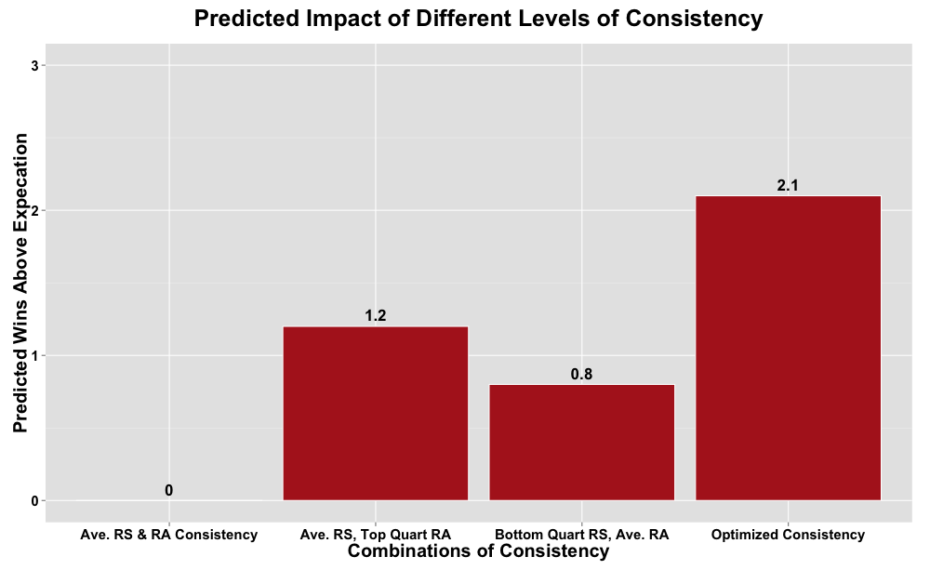
Better Reason (cont.)
Teams with optimized run prevention and run scoring consistency win, on average, two more games above their Pythagorean Expectation*
*The Hardball Times, 2014, http://www.hardballtimes.com/the-value-of-inconsistent-play-in-major-league-baseball/

Slide 11
Better Reason (cont.)
Controlling for Run Prevention, winning is driven by Run Scoring – so, teams want to score as much as possible
But when it comes to outperforming their expected wins given their run differential, a more consistent offense is better*
*The Hardball Times, 2014, http://www.hardballtimes.com/the-value-of-inconsistent-play-in-major-league-baseball/

Slide 12
So how do you quantify consistency?

Slide 13
Decisions, decisions, decisions…
The most recent approach that I’ve applied to teams is the use of Gini coefficients
Gini coefficients provide a measure of how equally some value is distributed amongst a population
Most commonly applied by economists to measure income and wealth inequality in a country
The measure is far from perfect
It’s great for data that isn’t normally distributed
But it doesn’t handle negative values well
And different distributions can give you the same Gini coefficient

Slide 14
Example of Gini Coefficients
Let’s say we have the following two countries and the values represent the income for each individual citizen
Country A | Country B
$1 | $30
$1 | $35
$1 | $40
$3 | $45
$3 | $50
$3 | $55
$4 | $60
$5 | $65
$5 | $70
$16 | $75
$78 | $80
$55 | $85
$200 | $90
$200 | $95
$400 | $100
Both countries have the same aggregate wealth, but how that wealth is distributed is quite different
Gini Coefficients range from 0-1, with 0 being the most equally distributed and 1 the least
Country A has a Gini coefficient of .75 – a highly uneven distribution, compared to Country B at .19, which is a fairly even distribution

Slide 15
Applying Gini Coefficients to Offense
Translating Gini Coefficients to individual hitters is actually pretty simple
Hitters : Countries
Games : Citizens
Runs : Income
For runs we can calculate Weighted Runs Created (wRC), but on a daily basis
Added a constant to all daily wRC scores to ensure all positive values
Then just calculate the Gini coefficient for the daily wRC for each player in each season
daily_wRC <- (((daily_woba - lg_woba) / woba_scale) + (lg_runs_per_pa)) * PA
constant <- 0 – min(wRC, na.rm = TRUE)
wRC <- wRC + constant

Slide 16
Calculating Individual Consistency
Individual game data from 1974-2015
Data split between all players and those with at least 100 games played while averaging >= 3 PAs per Game
Calculated raw Consistency scores, as well as z-scores to compare players across different eras and separate z-scores for everyday players

Slide 17
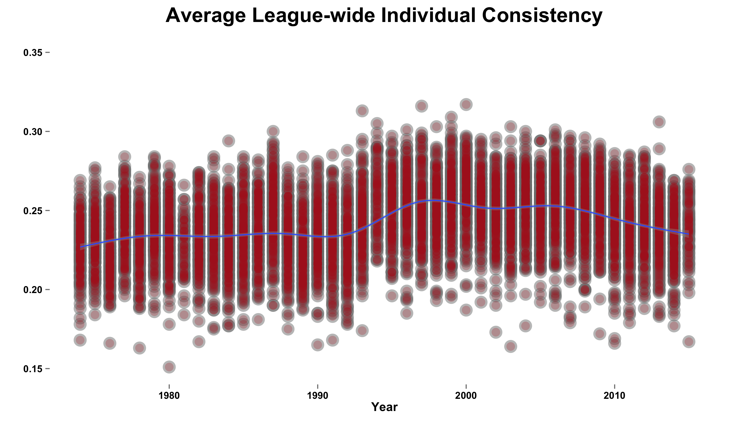
Consistency and Hitters

Slide 18
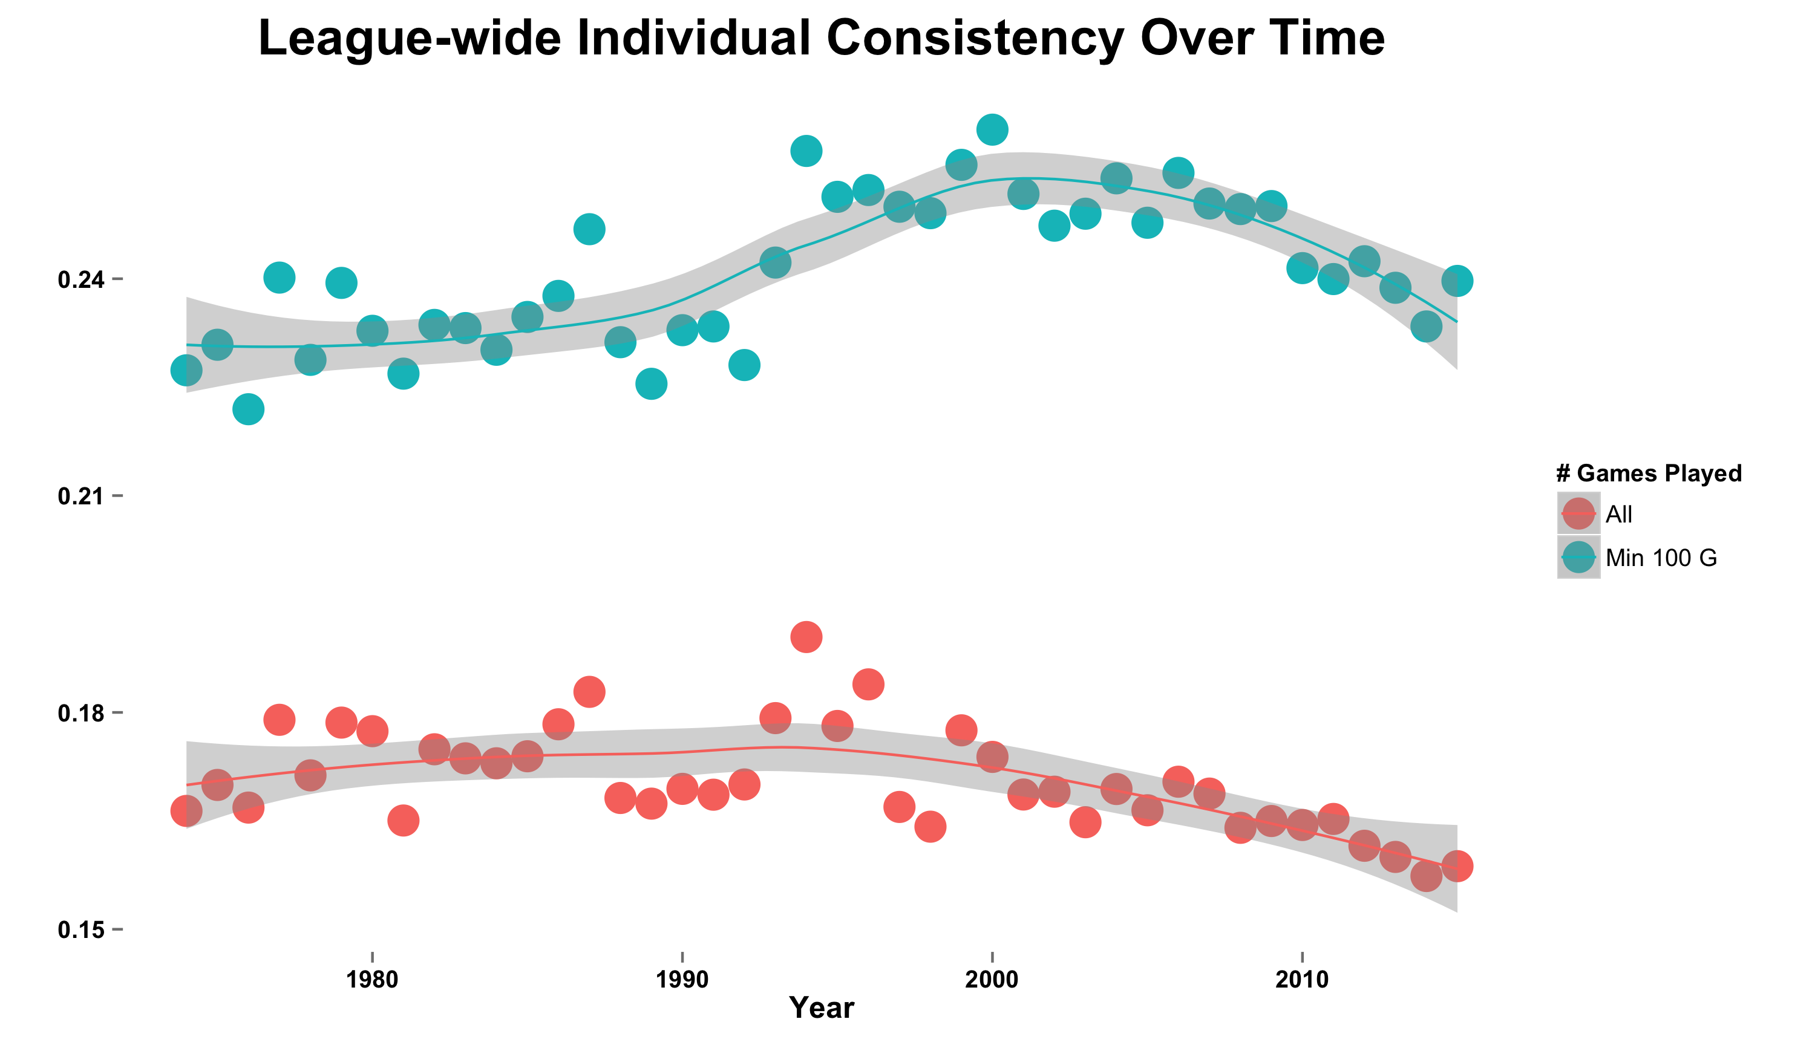
Consistency and Hitters (cont.)
Noticeable difference in average consistency when considering all players versus those that are more “everyday” players

Slide 19
Is Consistency a Talent and Somewhat Stable, Year-to-Year?
In it’s current form, there is some year-to-year relationship:
Year 1 Consistency has a 0.47 correlation to Year 2 Consistency
For everyday players, that correlation drops to 0.35
It’s possible that Consistency is simply a descriptive statistic that captures how a players distributes their performance in a given year, but can’t tell us much about the future
It’s also possible that Consistency is a statistic that needs more time to stabilize, much like BABIP
Or, Occum’s Razor: the metric isn’t that great

Slide 20
How Does Consistency Age?

Slide 21
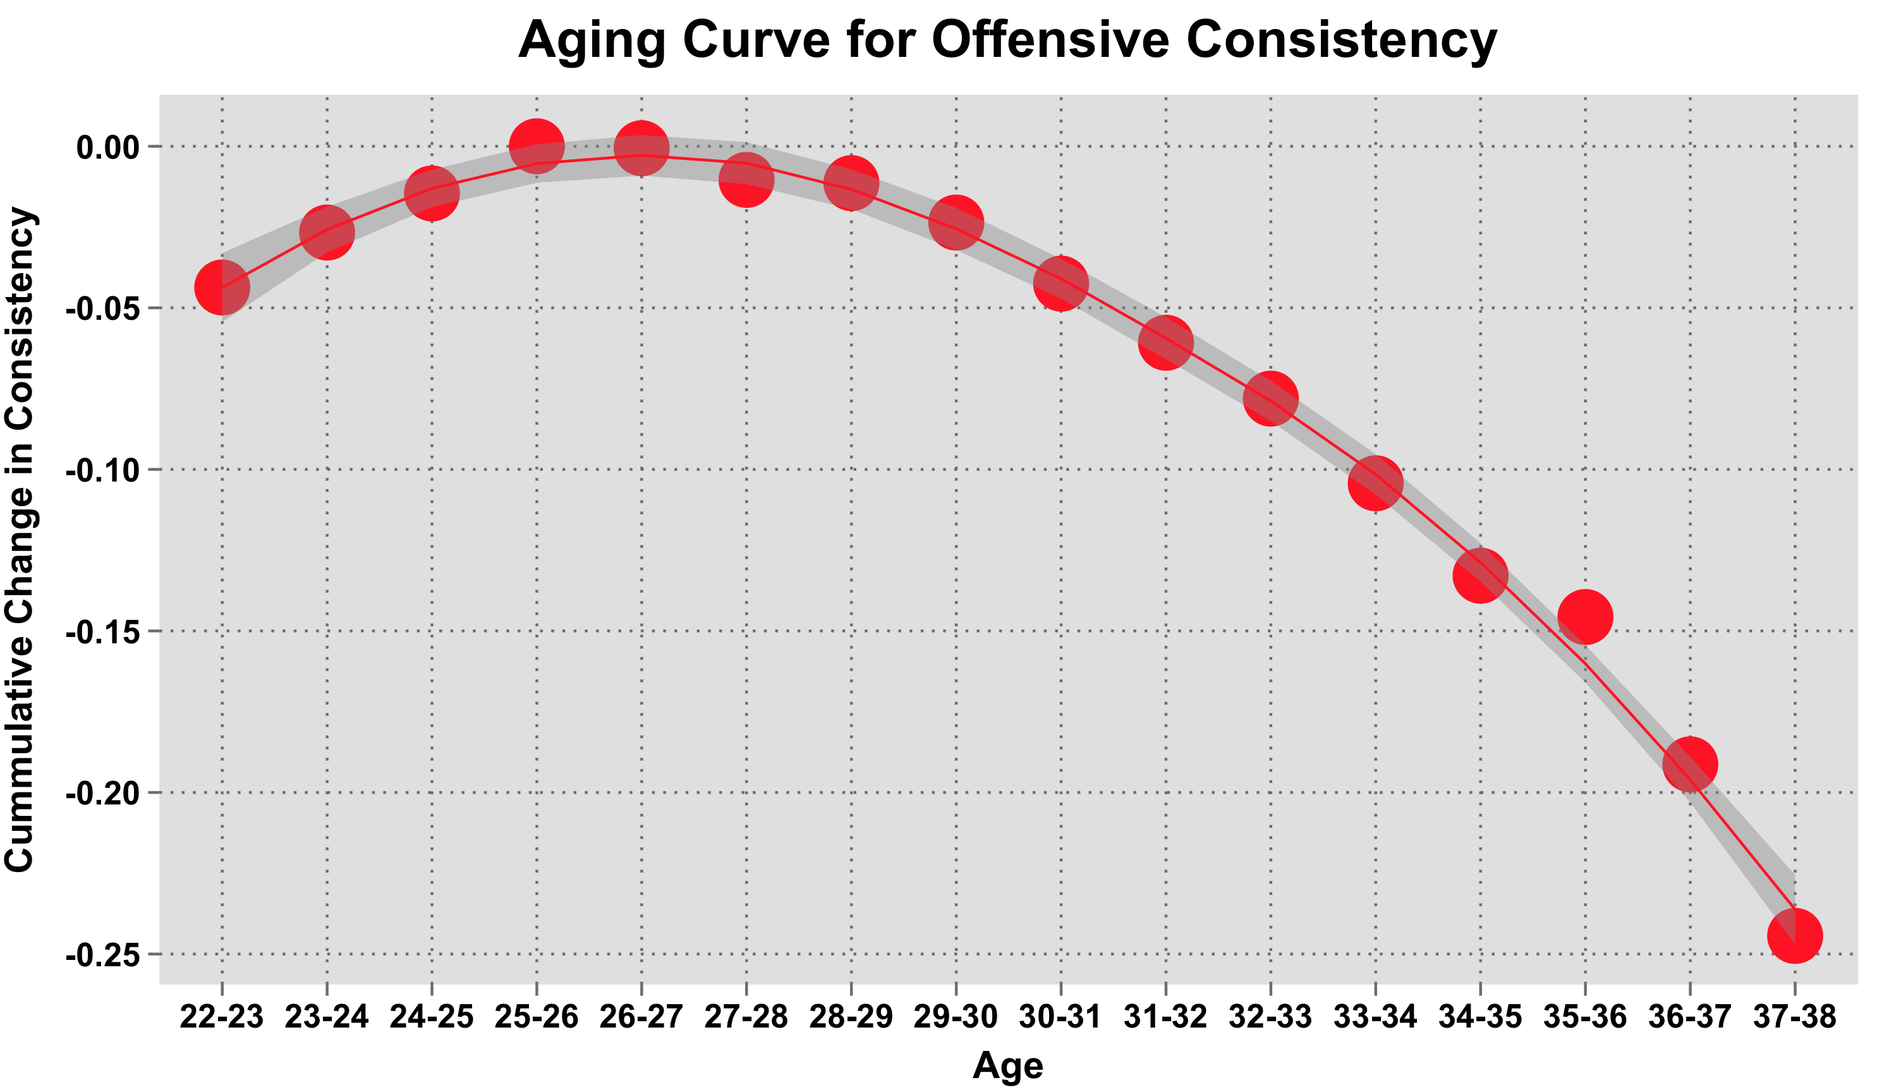
Methodology: Used the Delta Method – i.e. the difference in Consistency between two consecutive years for the same player

Slide 22
What Type of Hitters are Consistent?

Slide 23
What Types of Hitters are Consistent?
Methodology: Dominance analysis (given high correlation of independent variables) to show the relative importance of hitting metrics to same season consistency
Metric | Direction of Relationship
ISO | Positive
PA/G | Positive
wRC | Negative
GB/FB | Negative
OBP | Negative
G | Positive
Better run producers with a high on-base percentage and a higher number of ground balls to fly balls are more consistent
ISO alone has the strongest relationship to a hitter’s consistency; the higher the ISO, the lower the consistency

Slide 24
What Types of Hitters are Consistent?
Name | Season | G | wRC_CON | PA_G | zscore | zscore everyday | OBP | ISO | GB/FB | wRC | Age | wRC+
Bryce Harper | 2015 | 100 | 0.228 | 4.2 | 0.76 | -0.63 | 0.466 | 0.326 | 0.88 | 103 | 22 | 207
Paul Goldschmidt | 2015 | 106 | 0.231 | 4.4 | 0.79 | -0.47 | 0.447 | 0.237 | 1.15 | 95 | 27 | 170
Nelson Cruz | 2015 | 107 | 0.265 | 4.3 | 1.16 | 1.36 | 0.390 | 0.277 | 1.16 | 92 | 34 | 177
Mike Trout | 2015 | 104 | 0.262 | 4.3 | 1.13 | 1.19 | 0.397 | 0.310 | 0.89 | 91 | 23 | 181
Joey Votto | 2015 | 103 | 0.240 | 4.4 | 0.89 | 0.02 | 0.438 | 0.221 | 1.28 | 90 | 31 | 166
Josh Donaldson | 2015 | 107 | 0.268 | 4.4 | 1.19 | 1.52 | 0.364 | 0.276 | 1.20 | 88 | 29 | 156
Anthony Rizzo | 2015 | 105 | 0.241 | 4.4 | 0.90 | 0.07 | 0.402 | 0.241 | 0.75 | 86 | 25 | 158
Manny Machado | 2015 | 107 | 0.254 | 4.3 | 1.04 | 0.77 | 0.367 | 0.225 | 1.04 | 79 | 22 | 146
Andrew McCutchen | 2015 | 103 | 0.246 | 4.3 | 0.95 | 0.34 | 0.399 | 0.208 | 0.87 | 78 | 28 | 154
Prince Fielder | 2015 | 105 | 0.223 | 4.4 | 0.70 | -0.89 | 0.390 | 0.177 | 1.28 | 77 | 31 | 139

Slide 25
Summing Up
There appear to be measurable differences in how hitters distribute their runs over the course of a season
Hitters with higher OBP and lower ISO are generally more consistent in how they distribute those runs
However, Consistency itself seems quite inconsistent, year to year, at the individual level
This makes it difficult for teams to construct rosters in a way that maximizes consistent run production, but not impossible
Consistency is one more piece of information that a team can evaluate when comparing similar run producers

Slide 26
Thank You @BillPetti billpetti@gmail.com billpetti.tumblr.com hardballtimes.com/author/billpetti/ github.com/BillPetti

